Slide 1
Thoughts on Early Stars
A review of Stellar Evolution, projecting the composition
and evolution of stars formed in the Era of Recombination.
“Water, water everywhere…”
- Samuel Taylor Coleridge, The Rime of the Ancient Mariner
Presented June 1, 2018
plasma

Slide 2
Topics
Gas Theory, Differences between Hydrogen, Helium and “Metals”
Review of Population 1 and 2 stellar evolution
  Metallicity, Hydrostatic equilibrium, and How stellar fusion varies by size
How was early universe different from now?
  Zero metallicity defined, Redshift scaling impacts: matter density, stellar size
What kind of stars did that universe form?
  Stellar fusion options and limitations, Unique structural features
How did these early stars evolve?
  Comparison of stellar endpoints with and without metals
  Contributions to the Interstellar Medium

Slide 3
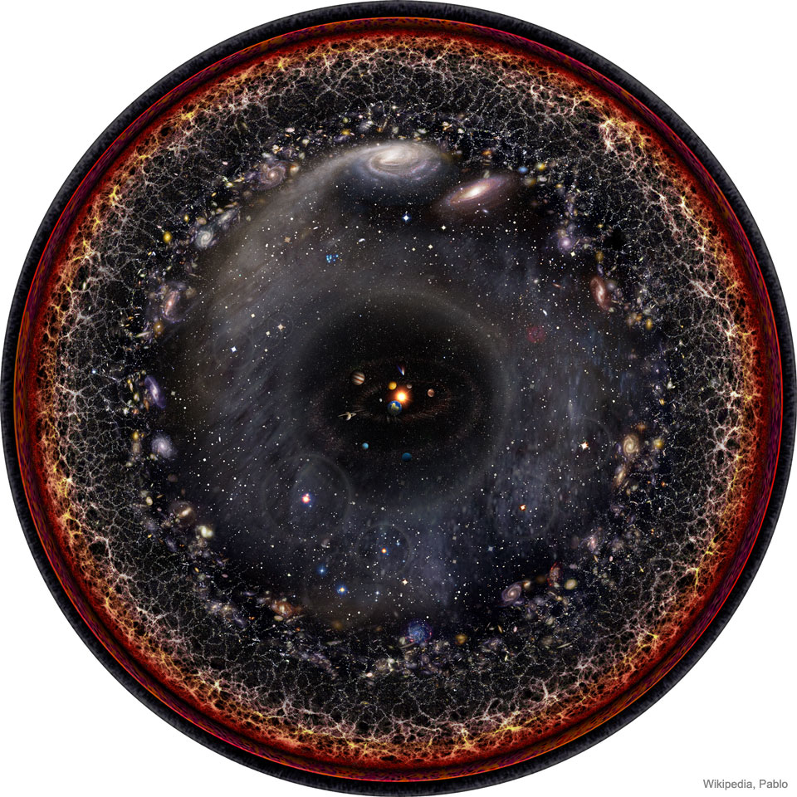
When was “Early?”
The Observable Universe
(APOD 5/8/2018)
“Illustrates the observable universe on an increasingly compact scale, with the Earth and Sun at the center…”
  Big Bang
  CMB – transparency
“Early”
  Re-ionization, first galaxies

Slide 4
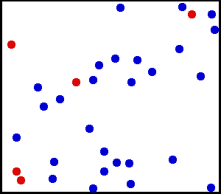
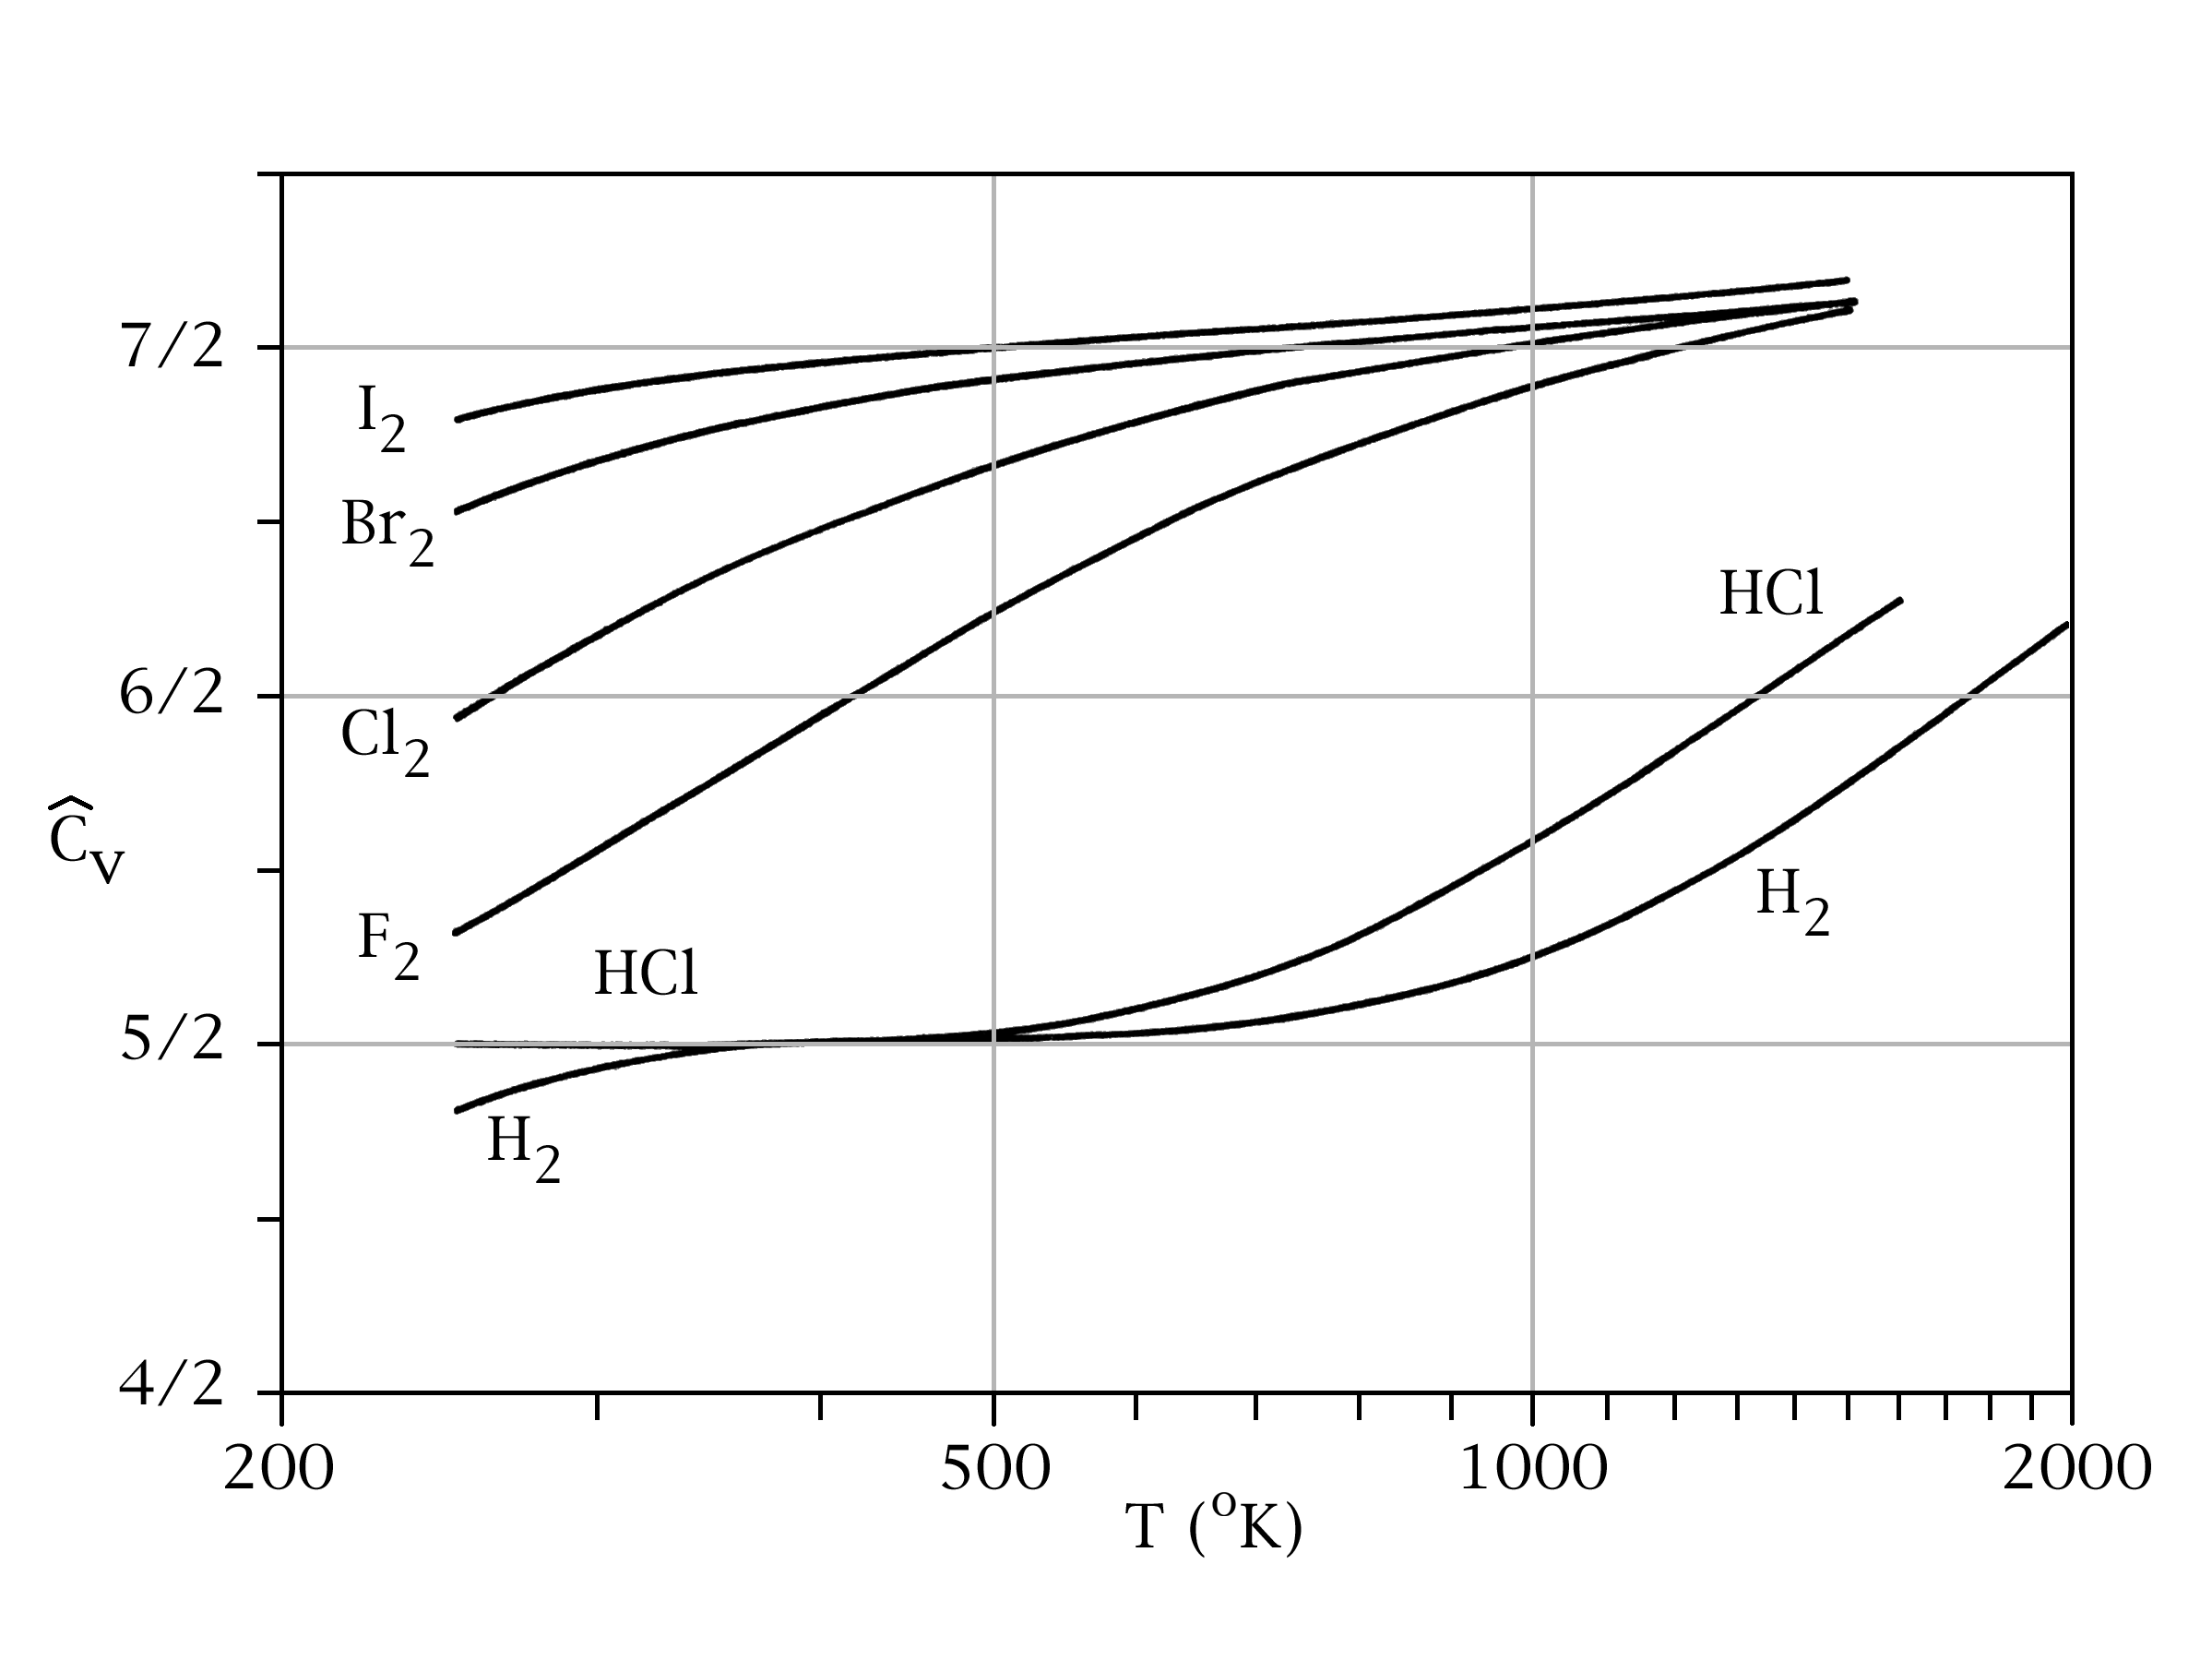
Kinetic Theory of Gases and Heat Capacity
Kinetic Theory posits that gas pressure on a surface is due to impacts from individual atoms on that surface.
Electron clouds of gas atoms and boundary interact
  PV = nRT – ideal gas law relating pressure, temperature
Assumes spherical atoms, with zero rotational inertia
  Molar Heat Capacity: degrees of freedom x ½ R
  Noble gases (He, Ne, etc.) obey this relation, Cv,m = 3/2R
Diatomic molecules more complex – rotation, vibration
  Rotation adds 2 degrees of freedom, so Cv,m = 5/2R @ STP
  Vibration temperature sensitive, max Cv,m = 7/2R
Big Bang condensation: plasma → atoms → molecules
  As H cools and forms molecules, its ability to hold energy rises
  Increased heat capacity means temperature falls where H₂ forms

Slide 5
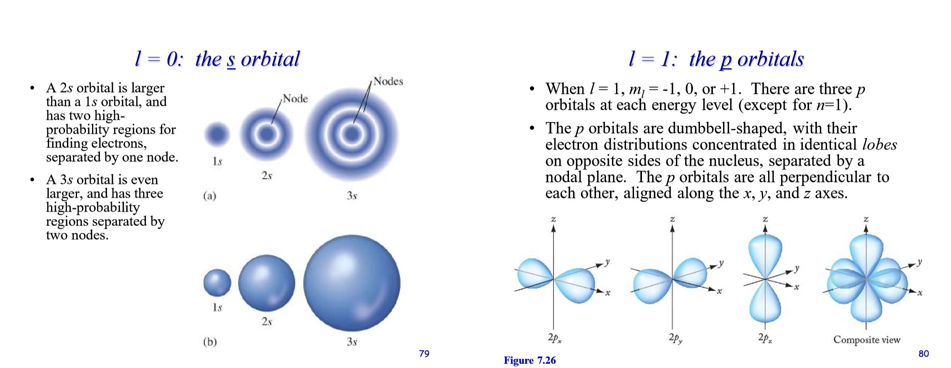
Differences between H, He and Metals
Hydrogen, Helium, Lithium, Beryllium
Boron, Carbon, Nitrogen, Oxygen, Fluorine, Neon
Matter and energy interact primarily through electron clouds.
Shape of electron cloud changes as the atomic number increases.
- spherical (“s” shell)
- lobed (p, d, f shells)

Slide 6
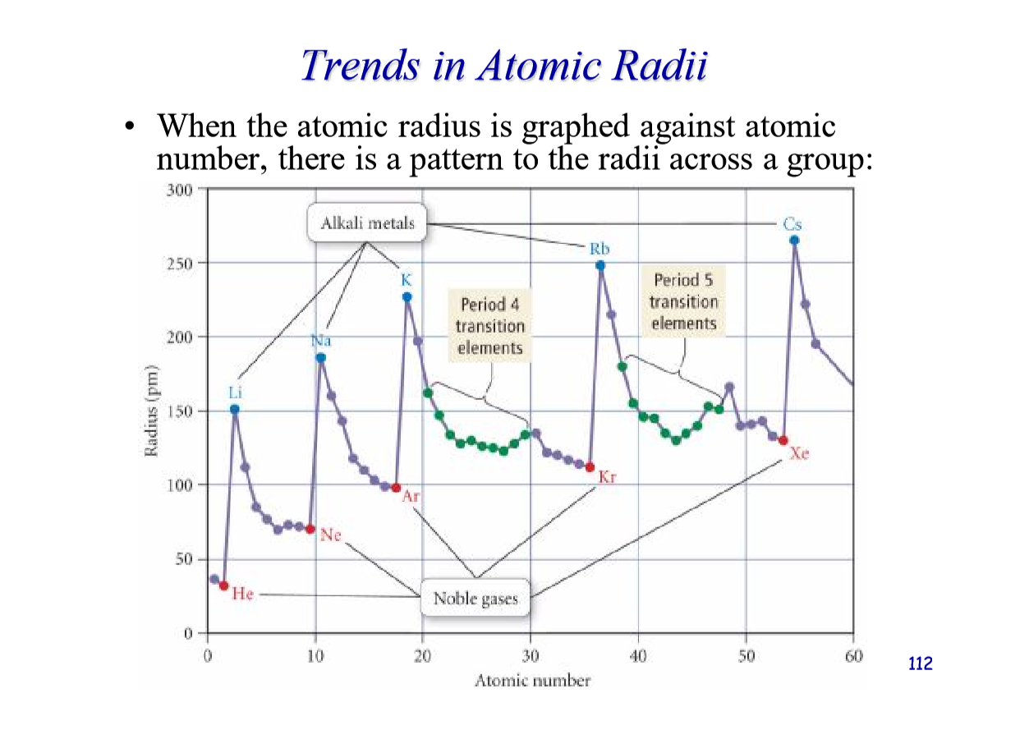
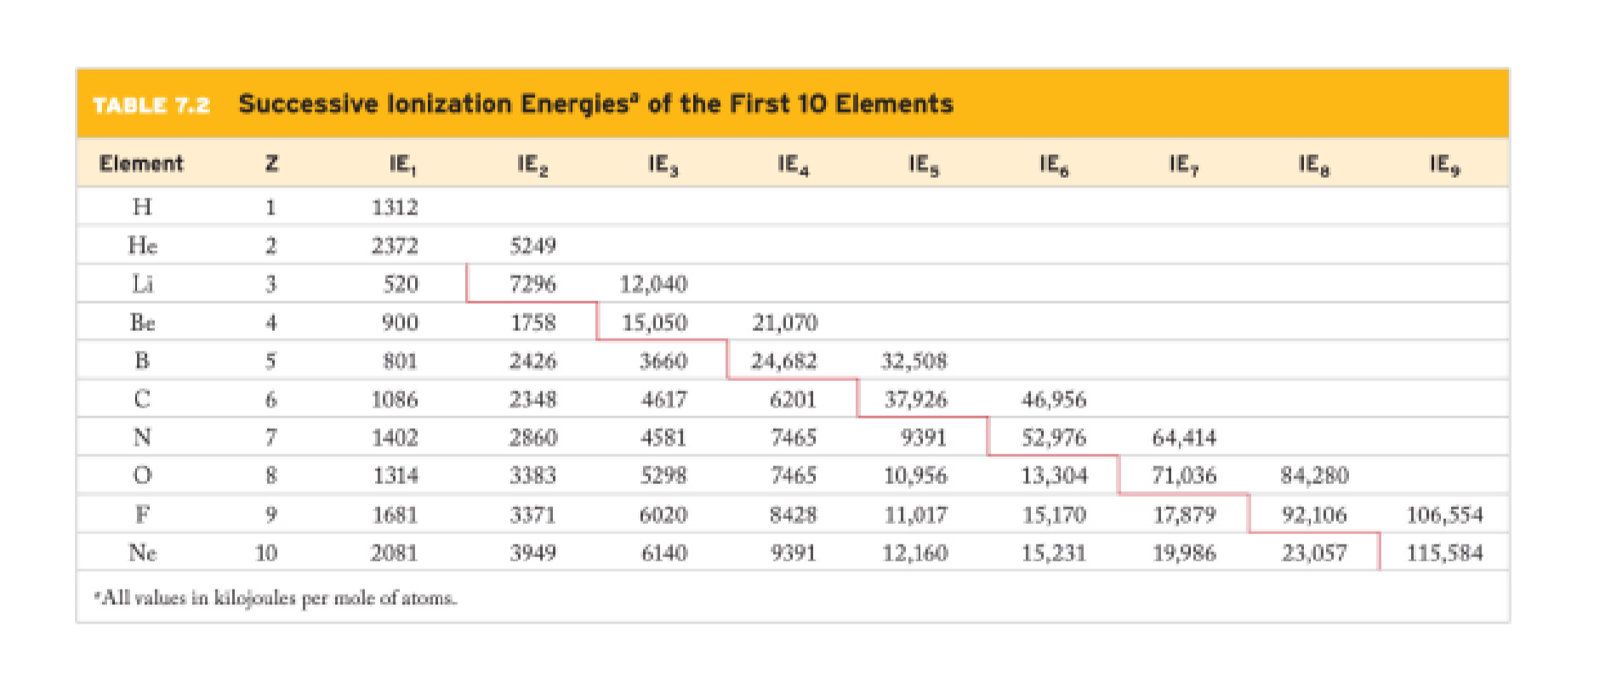
Differences between H, He and Metals
The size of electron clouds varies as atomic number increases.
- H, He only 25% the size of Li, half CNO
“First” ionization is removal of one electron.
- Hydrogen becomes plasma, others shrink a little in size.
Much greater energy required to remove additional electrons
- As atomic number increases, it becomes harder to make plasma.
- Hydrogen requires 0.1 Megakelvin; Oxygen requires 10 MK

Slide 7
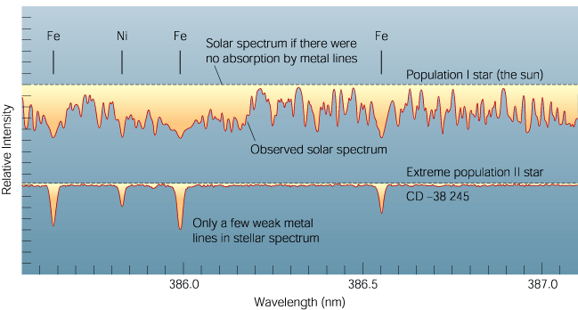
Stellar Populations
Today, Oxygen is the most abundant “metal” in the universe, and metals are ubiquitous. Even “metal poor” stellar spectra show Fe and Ni, the heaviest elements that release energy by fusion.
How do we define “zero metallicity?”
The Galaxy contains two populations of stars, distinguished by the abundance of atoms heavier than Helium — ‘metals’.
Population I stars
  found in the disk
  metal rich, relatively young
Population II stars
  found in spheroid (halo)
  metal poor, old (first generation of stars)
Today’s Universe
Population I: Many absorption lines also from heavier elements (metals).
Population II: Absorption lines almost exclusively from hydrogen.

Slide 8
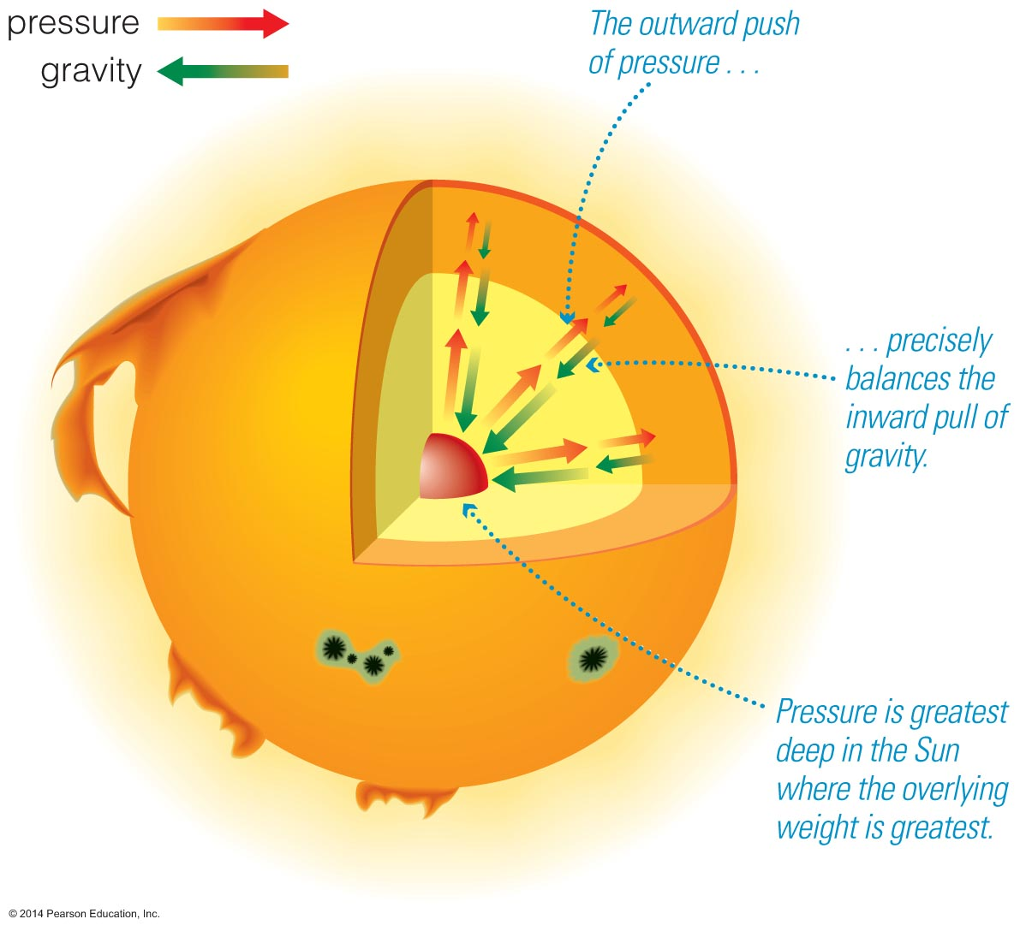
Hydrostatic Equilibrium
Hydrostatic equilibrium relies on radiation pressure against infalling gas to counter the force of gravity.
Stars form when ‘birth’ clouds undergo gravitational collapse
  Why do they stop?
  Main sequence stars are stable and long-lived
When fusion reactions ignite in the core, thermal pressure due to the energy released balances the gravitational force. The star has reached Hydrostatic equilibrium
H and He are fully ionized by UV radiation, forming plasma.
This plasma is a mix of bare nuclei – protons and α-particles – and free electrons.
Absent an electron cloud, plasma particles are 10,000 times smaller than atoms, giving radiation nothing to press against.
What happens when gravitational collapse meets little opposition?
Today’s Universe

Slide 9
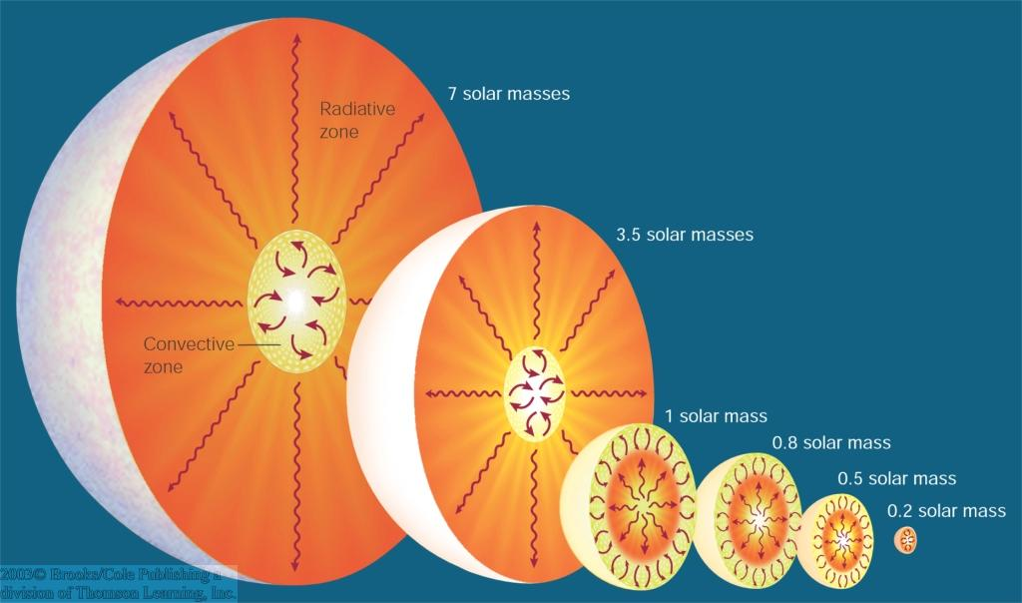
Energy Transport Structure
Today’s stars, near the Sun’s mass, use differing nuclear reactions to create Helium, depending on their size and core temperature
internal structure differs for stars much more AND MUCH LESS massive than the sun
Smaller stars use the Proton-Proton Chain reaction to form Helium because they don’t get hot enough to use the CNO process.
The CNO cycle requires Carbon as a catalyst. This reaction is not possible in a zero-metallicity star.
How does P-P Chain fusion change at temperatures usually dominated by CNO?
Inner convective, outer radiative zone
Today’s Universe
Inner radiative, outer convective zone
Entirely convective
CNO cycle dominant
p-p chain dominant

Slide 10
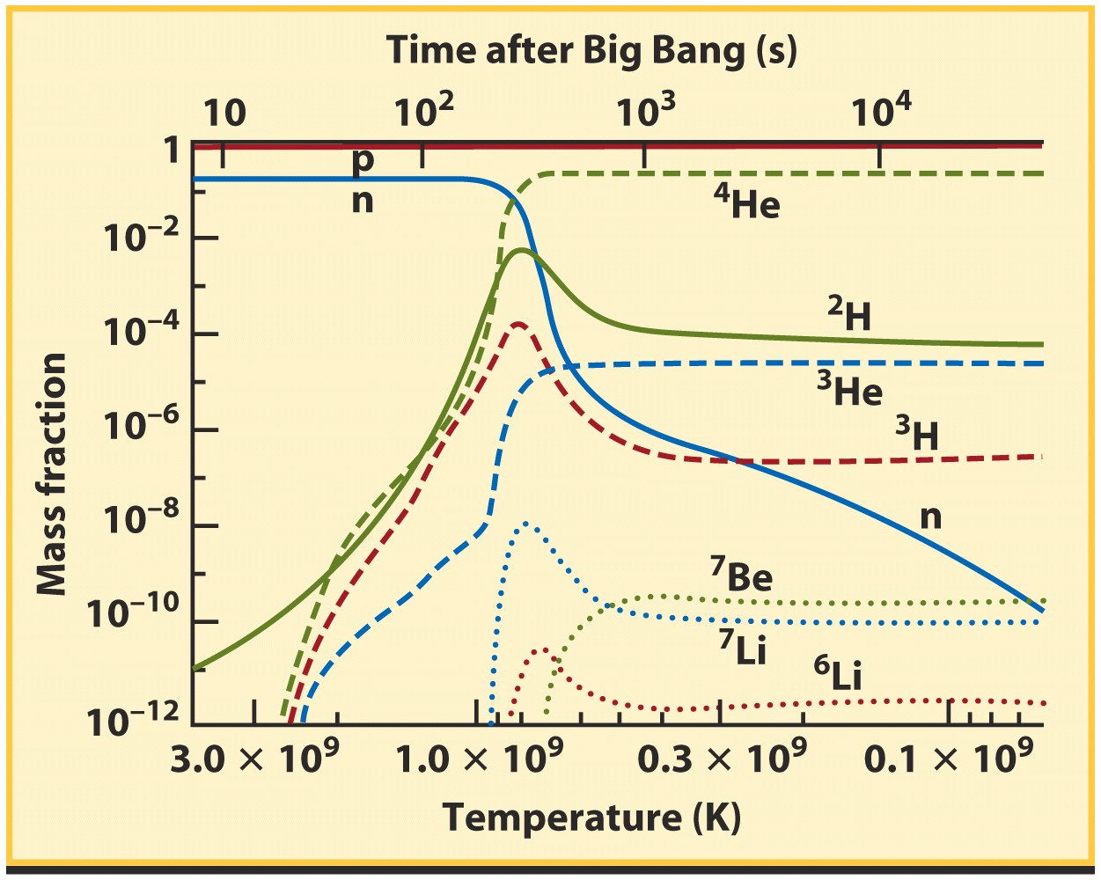
Big Bang Nucleosynthesis in more detail
First step in nucleosynthesis is formation of deuterium
But photons still energetic enough to break ²H apart
After ~ 3 mins photons no longer have sufficient energy to destroy deuterium (²H)
Helium and heavier nuclei form
  Helium nuclei — 25 % of mass
  Traces of deuterium, lithium 7
Ends when temperature is too low for further fusion (~15 mins)
p + n → ²H + γ
“Zero Metallicity” is defined by Big Bang nucleosynthesis.
Smattering of H and He isotopes down to 1 PPM
Smattering of Li and Be isotopes at less than 1 PPB
For reference, Oxygen is 8000 PPM by mass in our Sun.

Slide 11
Cosmological redshift and distances
Vacuum Densities Today:
IGM 40 atom/m³
ISM 10⁶ atom/m³
Earthly 10⁸ atom/m³
~ 10⁻⁹ gram/m³
Cosmological redshift (z) is a direct measure of the expansion of space
Let’s define a scale factor, s_{z}, representing the relative expansion of the universe.
This representative distance, indicates how lengths in the universe change with cosmic time.
Example: quasar at z = 2
λ/λ₀ = 1+z = 3
Scale factor: s_{z=2} = s_{z=0}/3
Representative volume would then be V_{z=2} ~ s_{z=2}³ ~ s_{z=0}/27
Redshift:
Zero metallicity stars formed at 20 < z < 100.
Scale factor: 1/21 < s < 1/101
Representative volume: 1/9,261 < V < 1/1,030,301
Matter density is much higher, but collapse into stars is hampered by thermodynamics – todays metal-based processes for cooling don’t work yet.
Jeans Mass much higher than today
Initial Mass Function for stars heavily skewed to BIG
Does formation of molecular hydrogen seed the IMF?
➔

Slide 12
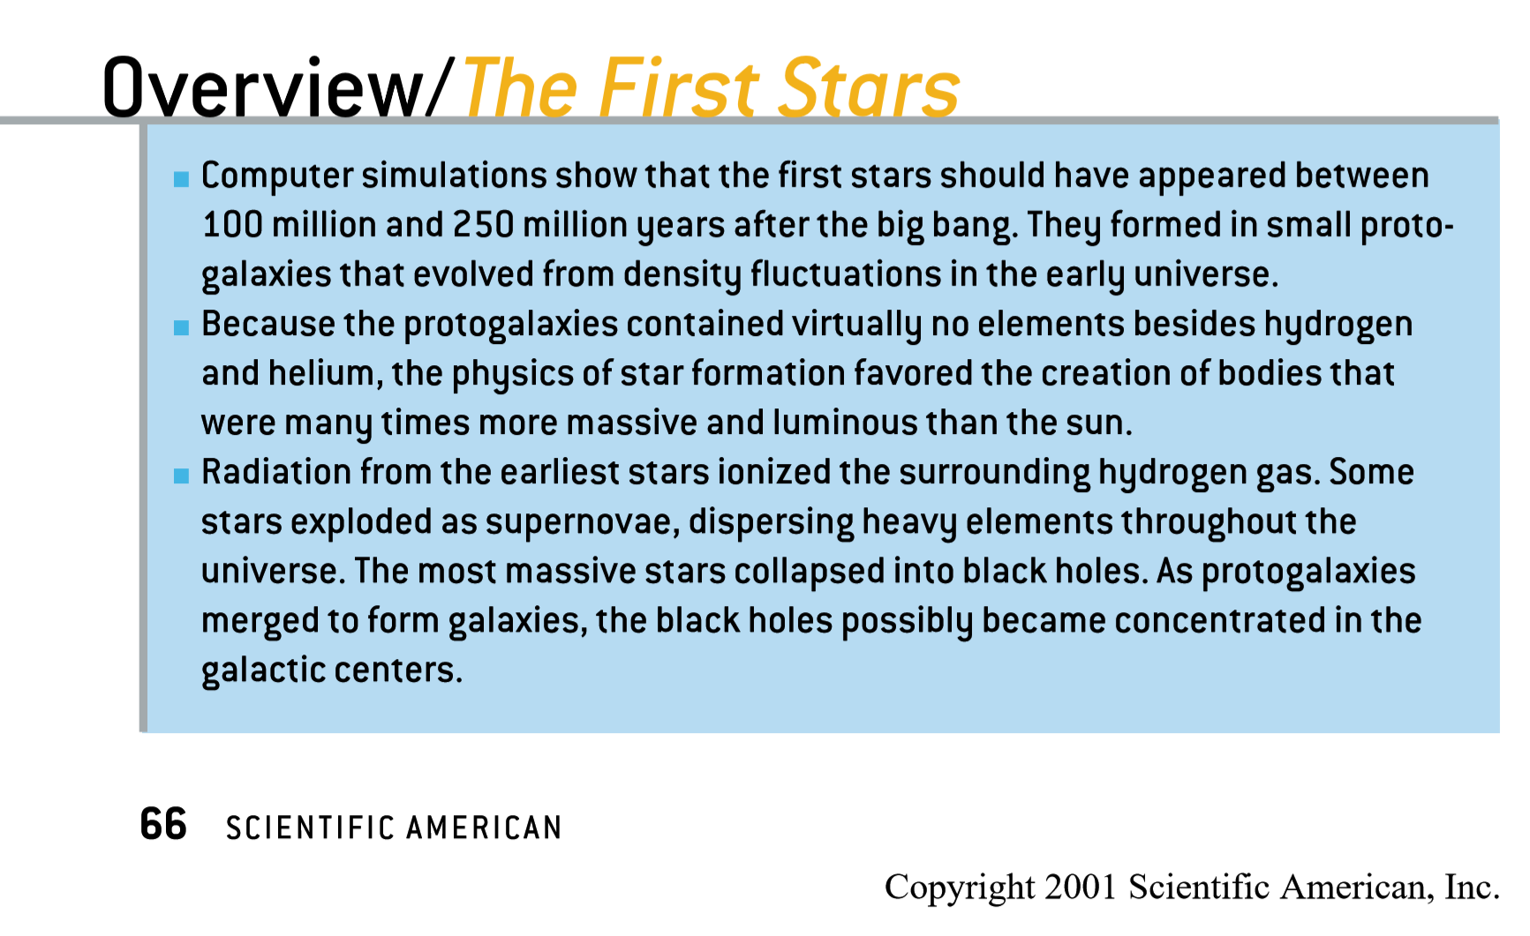
From: “The First Stars in the Universe” Scientific American, December 2001, pp 64-71.

Slide 13
Note that P-P cannot form Carbon.
Carbon needs Triple Alpha to start.

Slide 14
Model of First Stars?
Effective photosphere (100,000 K)
Infalling outer H₂ → H₁ → ¹H envelope
T = 10 MK – P-P I fusion starts
T = 14 MK – P-P II fusion starts
T = 28 MK – P-P III fusion starts
Radiation pressure drops due to shift in fusion path increasing energy released as neutrinos
T = 100 MK – Triple Alpha fusion starts rate depends on T⁴⁰, density²
T >> 100 MK – Alpha ladder fusion
C from Triple Alpha turned to O
T ~ 10 GK – electron-positron pairs *
T ~ 20 TK – proton-antiproton pairs
* Note: Gravity is winning until this point

Slide 15
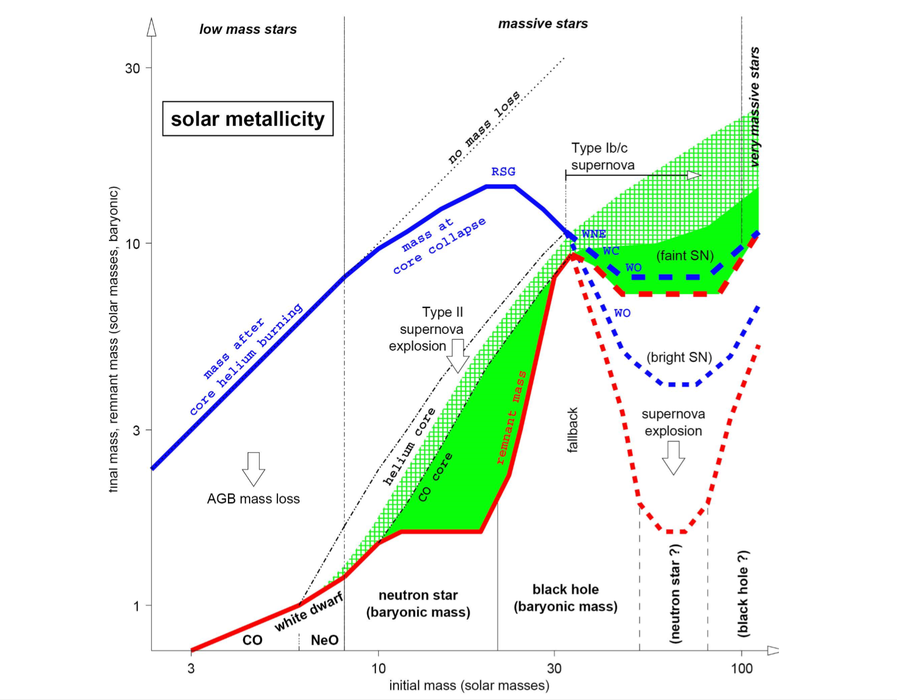
Today’s stars’ fate depends on their mass.
Smaller stars lose mass on AGB leaving a white dwarf
Massive stars explode leaving a neutron star or black hole.
The largest stars explode more violently, dispersing a higher fraction of their mass.
The largest stars observed today are ~100 Msun, the most massive stellar remnant, ~10 Msun.
From: The Evolution of Population III Stars, Stephen Redman, Astronomy 534

Slide 16
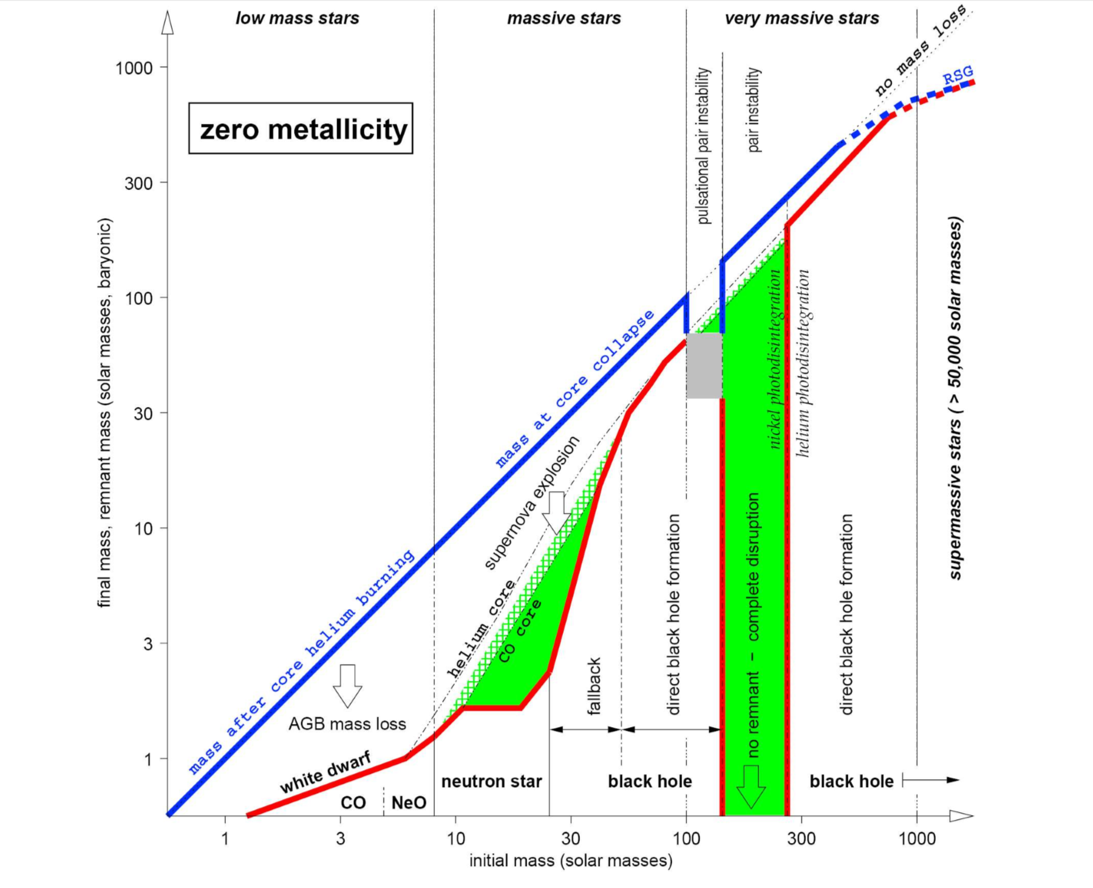
Zero metallicity stars follow a similar pattern, but on a different scale. End points are similar below 30 Msun, but…
Less mass loss before core collapse
“Fallback” period ends with direct BH
Without metals, stars we consider “massive” disperse little mass into ISM
Above ~300 Msun, BH forms directly.
100-300 Msun stars die in “pair instability” supernova
Core temperature rises high enough to form antimatter at their core
PISN are highest mass stars that release elements into the interstellar medium, leaving no remnant.
All larger stars disappear.
Note Differences in scale of the plots…
Initial mass now extends past today’s limit of ~100 Msun
Final mass extends 33x higher, reflecting higher initial mass, less mass loss
From: The Evolution of Population III Stars, Stephen Redman, Astronomy 534

Slide 17
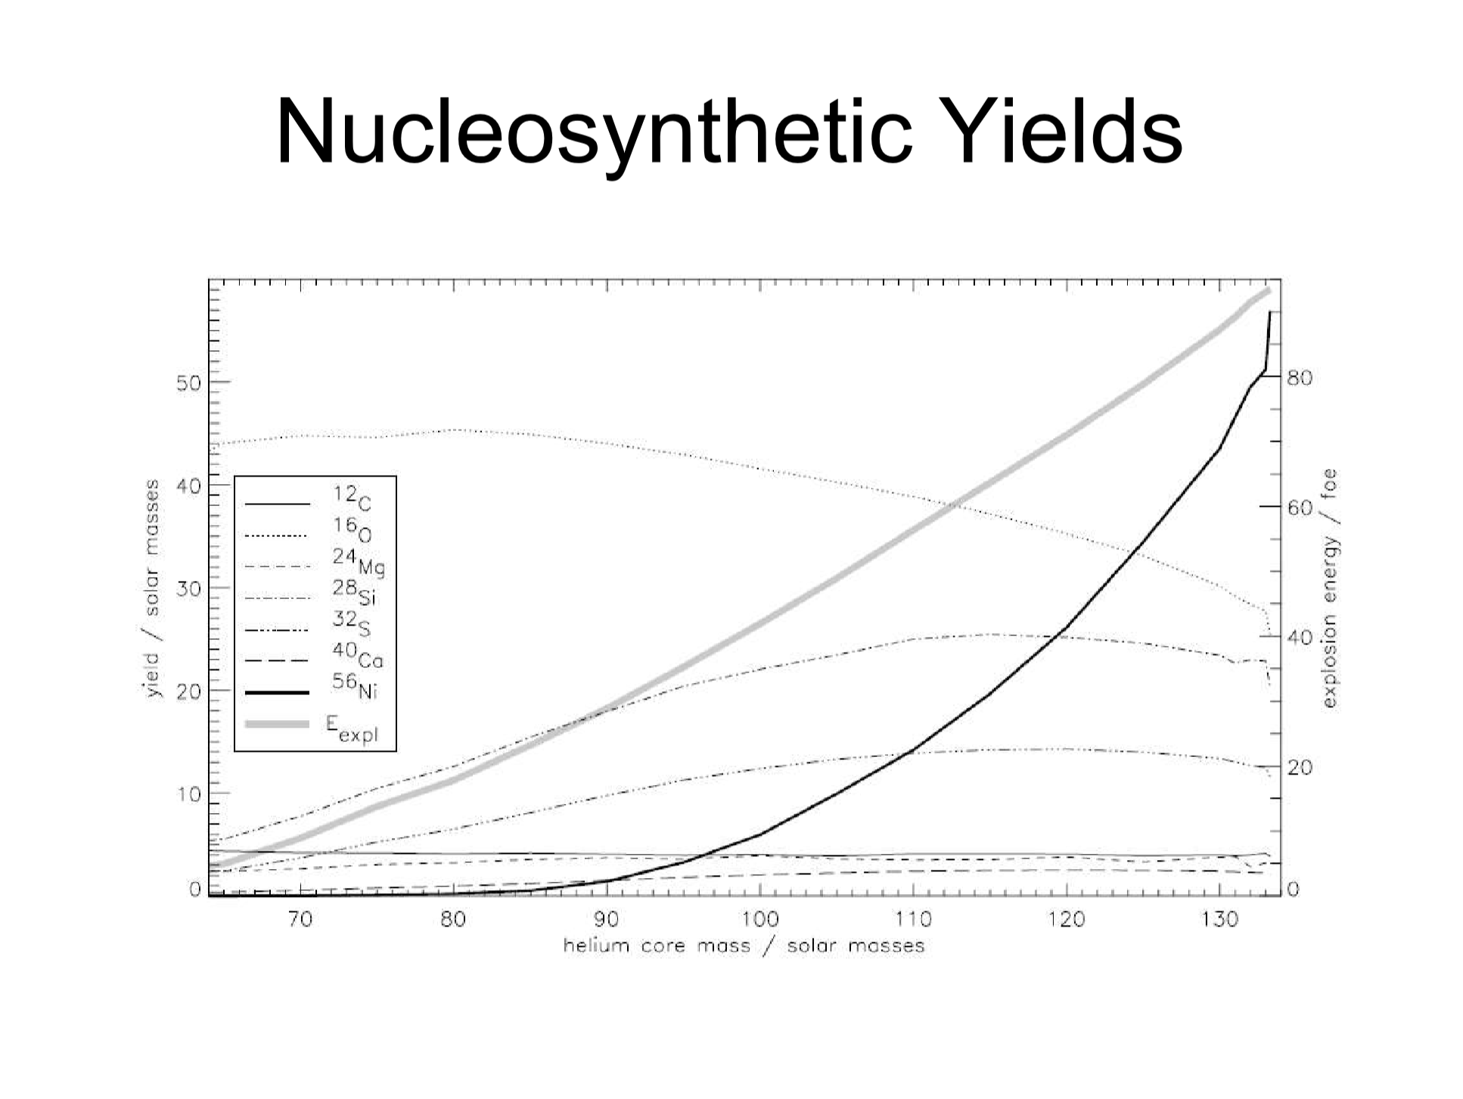
But it gets better…
PISN create massive amounts of light metals, lighter than Ni.
Oxygen is the big winner, comprising as much as half the matter dispersed.
Other elements are all on the exothermic side of nucleosynthesis.
Dispersal into the ISM would pollute existing stars, seed GMCs with metals we find in the next generation of stars.
Oxygen
Nickel
Silicon
Sulfur
Carbon
Magnesium
Calcium
From: The Evolution of Population III Stars, Stephen Redman, Astronomy 534

Slide 18
Summary
First stars had 10⁻¹⁰ metals compared with Hydrogen and Helium
  Lack of metals hampered molecular cloud cooling, driving up star size
  High mass density, large Jeans Mass, led to very large stars
Stars with no metals had no way to oppose the inflow of matter
  H and He are fully ionized at less than 1 MK, forming plasma (nuclei & electrons)
  Plasma has no cross section for photons to “press” on, to create equilibrium
  Proton-proton reaction is not temperature sensitive, but shifts energy into neutrinos
Reduced radiation pressure triggers runaway gravitational collapse…
  Onset of Triple Alpha process fusion, with sharply rising temperature and pressure
  Onset of positron-electron pair production, which again drops photon energy, but in a recoverable way should temperatures and pressures fall…
Eventually, collapse reverses… and the antimatter core disperses everything!

Slide 19
Acknowlegdgements
Stellar Astronomy Course Materials, Physics 104, (author unknown), RIT
“The Evolution of Population III Stars” Astronomy 534, Stephen Redman, Penn State
“The First Stars in the Universe” Scientific American, December 2001, pp 64-71.
Wikipedia Articles:
Heat Capacity
Proton–proton_chain_reaction
CNO_cycle
Triple-alpha_process
General Chemistry, CHEM 1411, Mr. Kevin A. Boudreaux, Angelo State University

